Slide 1
Food Safety Portal
By:
Vikendu Singh(RA1611008010160)
Shardul Silswal(RA1611008010660)
Pranav Gupta(RA1611008010100)

Slide 2
Objective:
To provide an application which allows residents and visitors of a city to find out more about food related aspects about the city. Aspects include information about restaurants and market certifications and what to look for local diets and/or delicacies, or even a restaurant guide.

Slide 3
Users of the System:
1. City residents
2. Visitors
3. City employees

Slide 4
Attributes of the model:
1. User accounts
2. Review forms
3. Comments/Complaints
4. Rating
5. Search restaurants
6. View Restaurants
7. Modify accounts
8. Update website

Slide 5
Requirements
Hardware:
Processor: Intel i3
Hard disk: 40GB
Ram: 512MB
DVD drive: 1
Software:
Operating System: Windows XP/Linux/Mac

Slide 6
Module Description
All users have their own profiles in FSP.
City residents and visitors can search for restaurants and make online booking. They can also submit feedback on any restaurant.
City employees can view record of their customers (regular customers, weekend customer or new customers).
Restaurant guide views and manages the booking, performs day open and close activities and calculates his commission. He also sends reports to admin.
Admin has the authority to add/delete users, grant permission to city employees and restaurant guide to generate and view. He also views the complains and feedback of users and takes necessary actions.

Slide 7
UML DIAGRAMS

Slide 8
USE CASE DIAGRAM

Slide 9
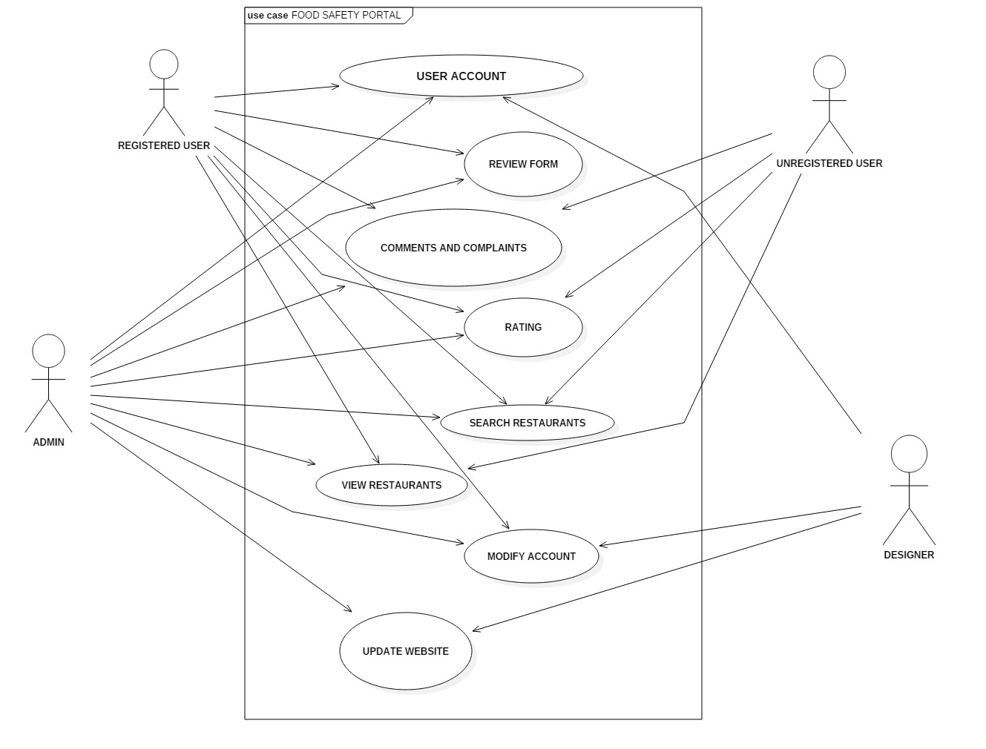

Slide 10
The use case diagram features the users of the system along with the services offered to the users. The actors in the diagram are users, admin, restaurant and designer. The diagram showcases the services like creating account, searching restaurants, see ratings, give feedback, file complaints, etc. It also includes the payroll of the employee along with any perks or bonuses to be added in the salary.

Slide 11
CLASS DIAGRAM

Slide 12
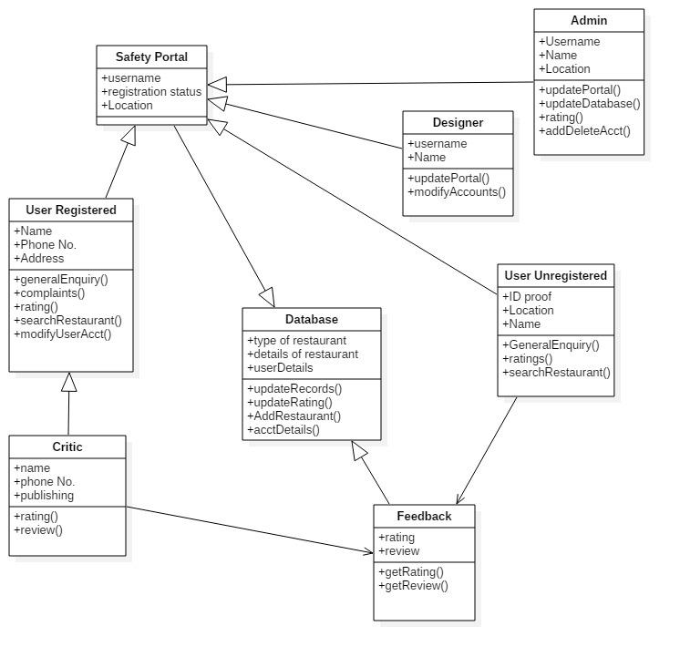

Slide 13
The class diagram is composed of various classes having different attributes. All the classes are interconnected to each other. The administrator and employee class are connected to the people class as the attribute of this class distinguish between them.
Further the database keeps a record of thr feedback input by registered, unregistered user and the admin.

Slide 14
Sequence Diagram

Slide 15
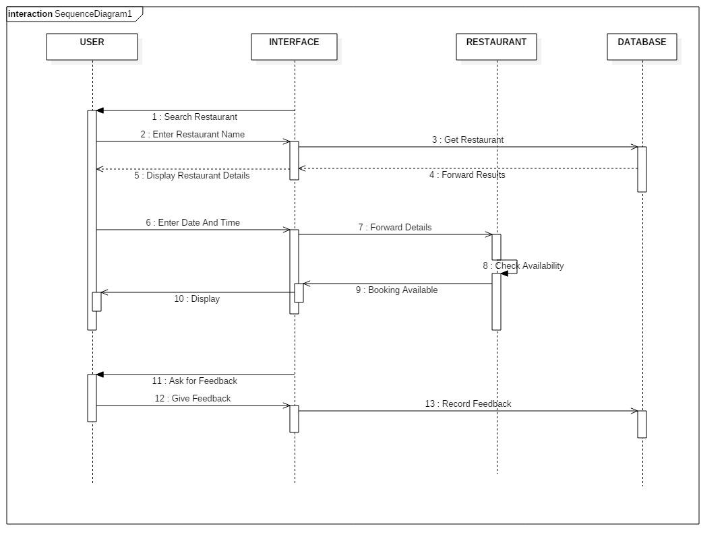

Slide 16
The sequence diagram consists of the user, interface, restaurant, and the database.
Firstly, the user inputs his review of the eatery and then through the interface it is approved by the admin and uploaded to the database by the System designer.
At this stage the review is visible to everyone including unregistered user.

Slide 17
Activity Diagram

Slide 18
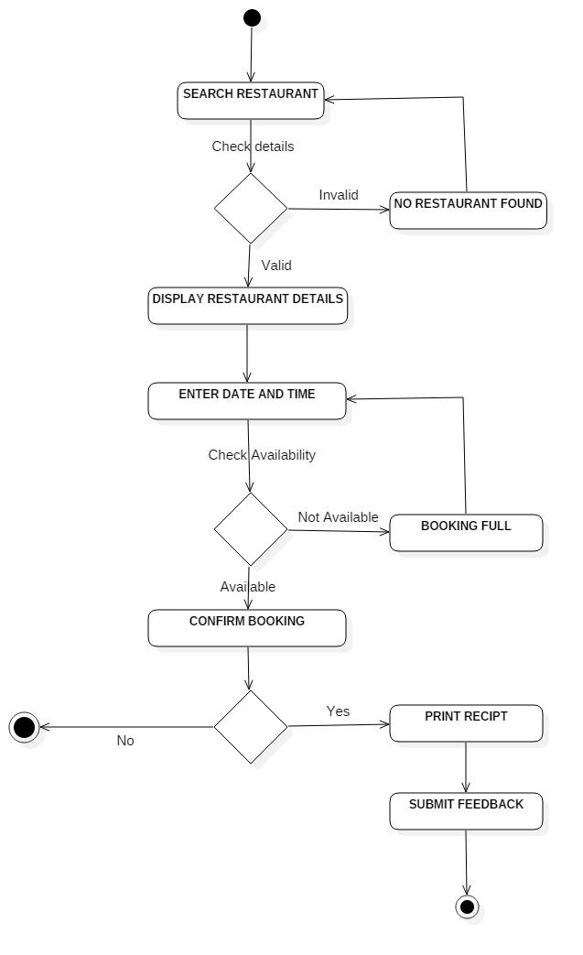

Slide 19
In the activity diagram the user is asked about the restaurant details and the corresponding reviews of various restaurants show up.
Which can be separately seen as either by Registered User and/or by unregistered user.

Slide 20
Swim Lane diagram

Slide 21
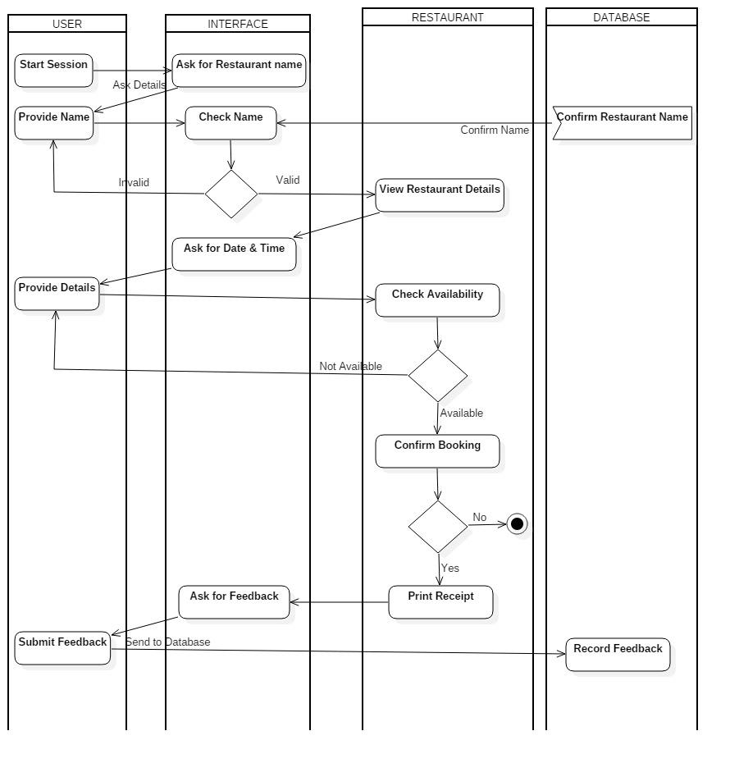

Slide 22
The session starts with the portal asking the user for a restaurant name, address and the corresponding name along with reviews show up.
This portal also enables the user to contact the restaurant directly for a booking.
Furthermore, the portal gives the option of reviewing the restaurant after the user dined there.

Slide 23
Start Machine diagram

Slide 24
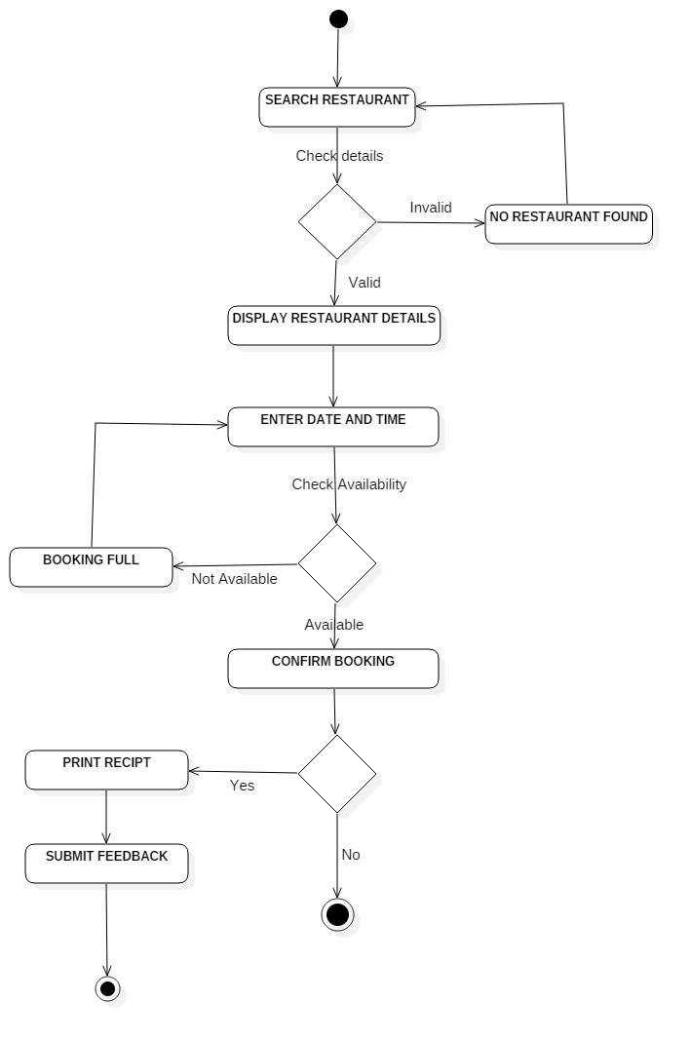

Slide 25
The start machine diagram starts with the restaurant details, if the input is correct then the portal will direct you to the reviews section of that particular restaurant.
It will also help you to book and confirm your booking with the restaurant, it also provides a payment gateway to do so.

Slide 26
Component diagram

Slide 27
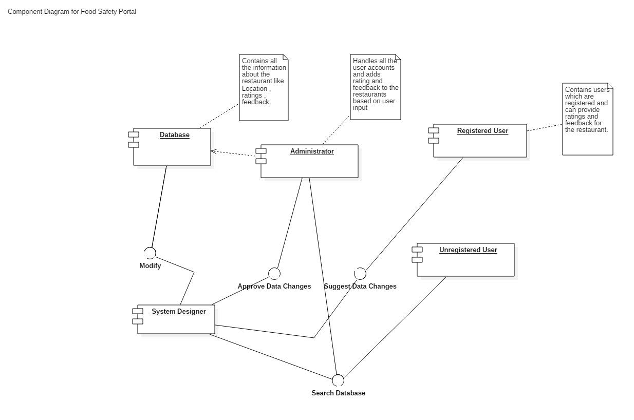

Slide 28
The component diagram is composed of 5 components; The registered user, the unregistered user, the admin and the system designer along with the database.
The database gets the restaurant details after they have been entered by the user of all kind and further approved by the admin.
The system designer in this responsible for the maintenance of the interface and updating it regularly.

Slide 29
Deployment diagram

Slide 30
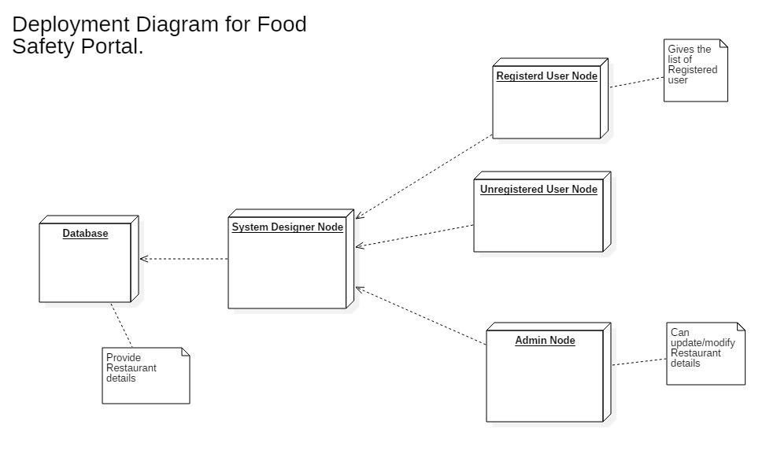

Slide 31
The deployment diagram consists of total 5 nodes;
The database holds the information about each and every restaurant.
The User nodes contain information about the users like when and where they submitted information about any restaurant.
The admin node is responsible for approving all the information that has been entered by the users.

Slide 32
Conclusion
Food Safety plays an important role in any Locality/City. The food safety portal will help users far and near determine whether or not a place has been reviewed positively or negatively by the vast majority of the users.
While we were doing this project, we understood that Food Safety has a major role to play in the health and well being of a Locality. And to improve the present state of the society the Food Safety Portal must be treated properly as it forms an integral part of the society.
We understood the need for OOAD as it helps in defining the structure and the working of a system so that we can refer it whenever needed. All the diagrams helped us to understand the functioning of the system efficiently.

